Slide 1
SALOoNBOOK APPLICATION

Slide 2
Problem Statement
Being a salon client today is inconvenient. You have to remember that you need to make an appointment, then hope you remembered during business hours, and finally scramble to find the phone number and take time out of your busy day to make the call. And never mind finding user reviews of local salons and stylists; tracking those down somewhere on the web is a headache that most don’t even attempt.

Slide 3
Class diagrams

Slide 4
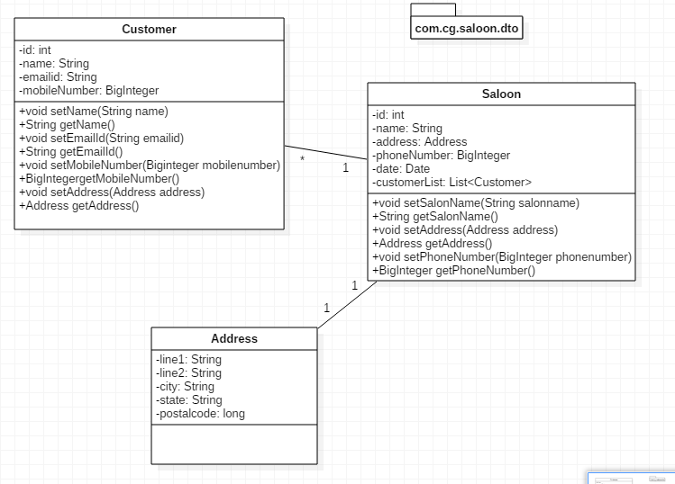
Dto

Slide 5
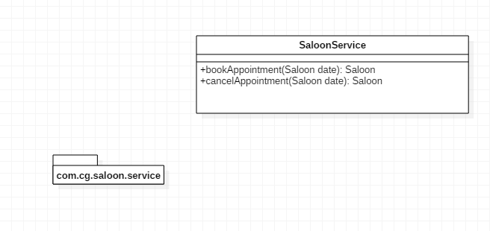
Service

Slide 6
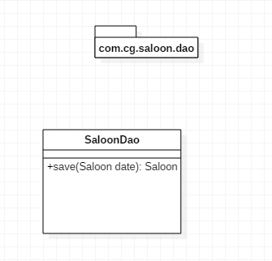
Dao

Slide 7
Thank you

